Slide 1
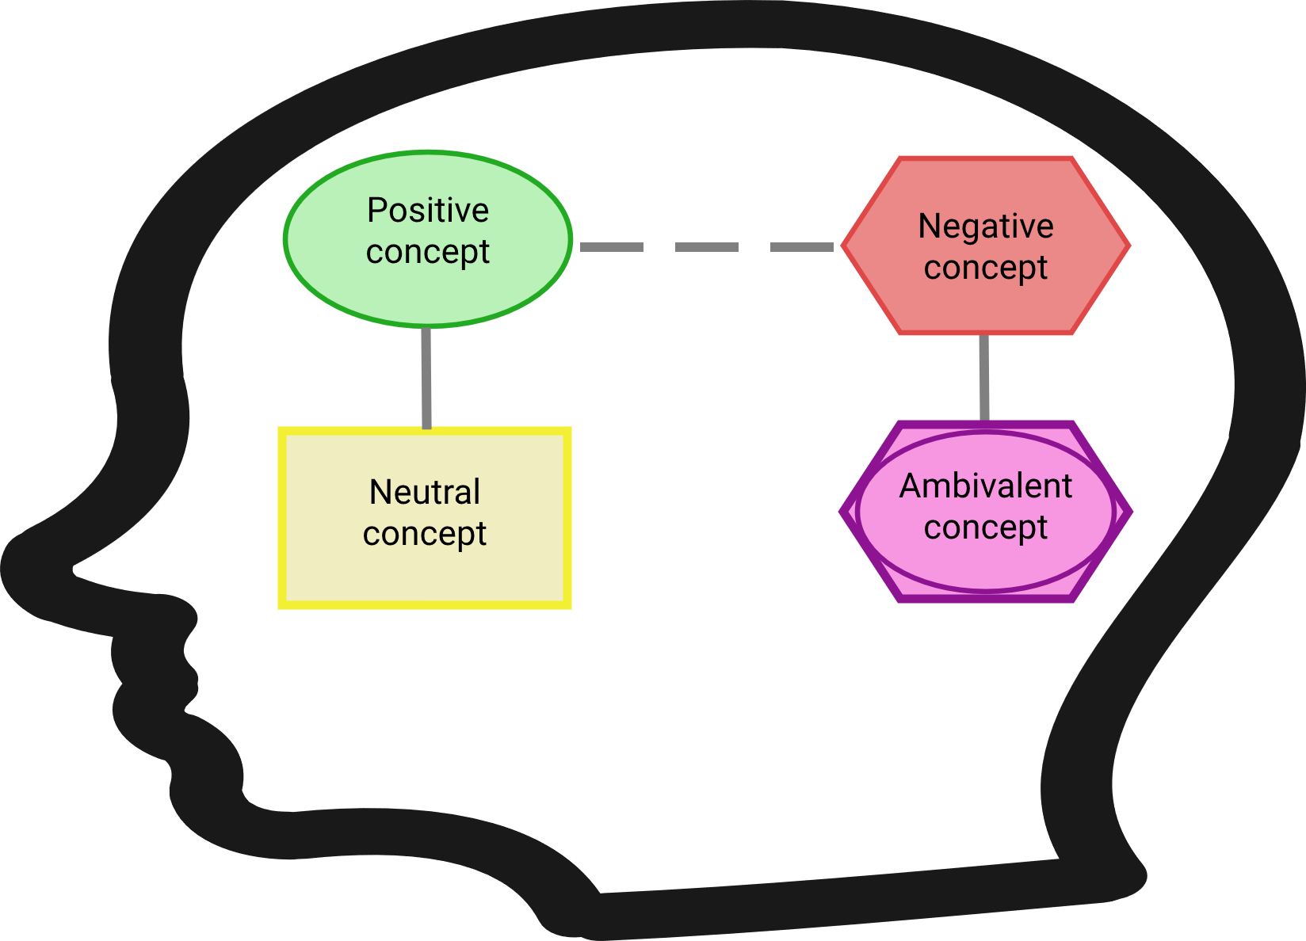
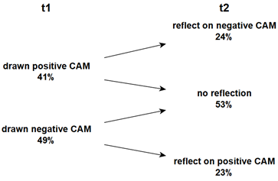
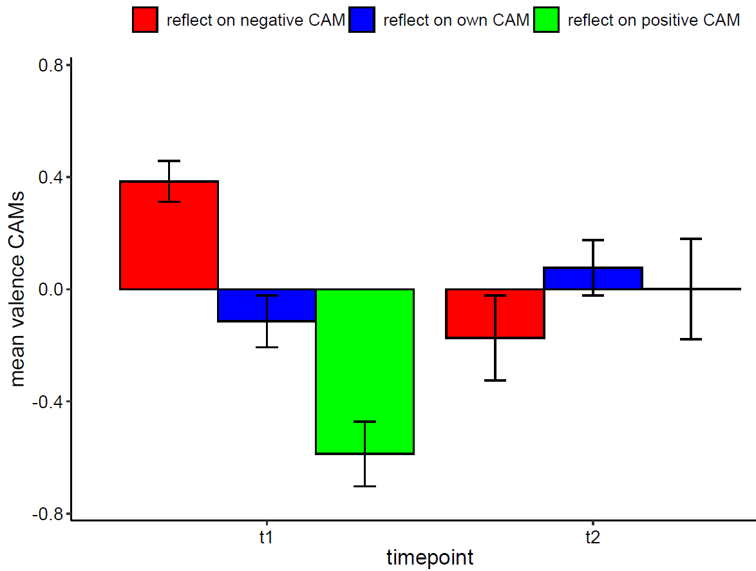
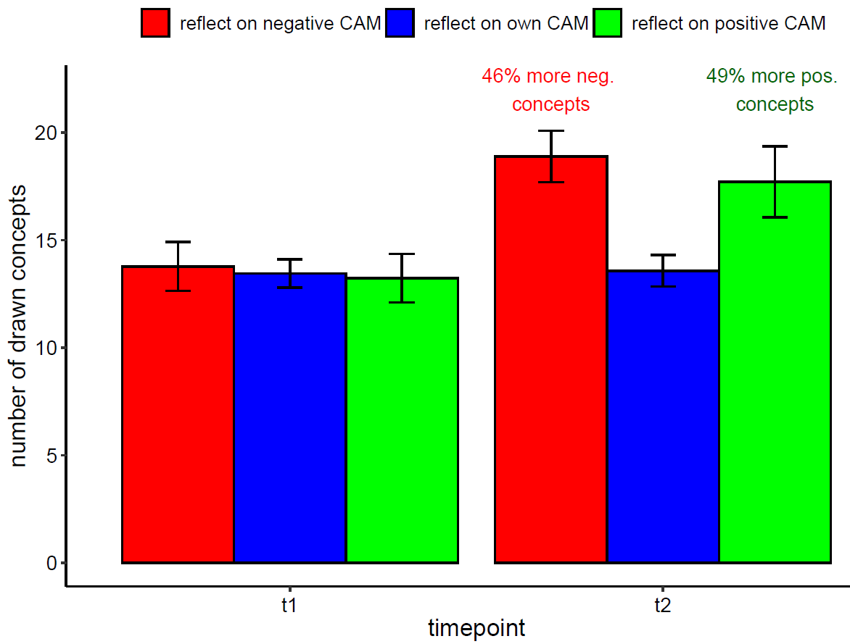
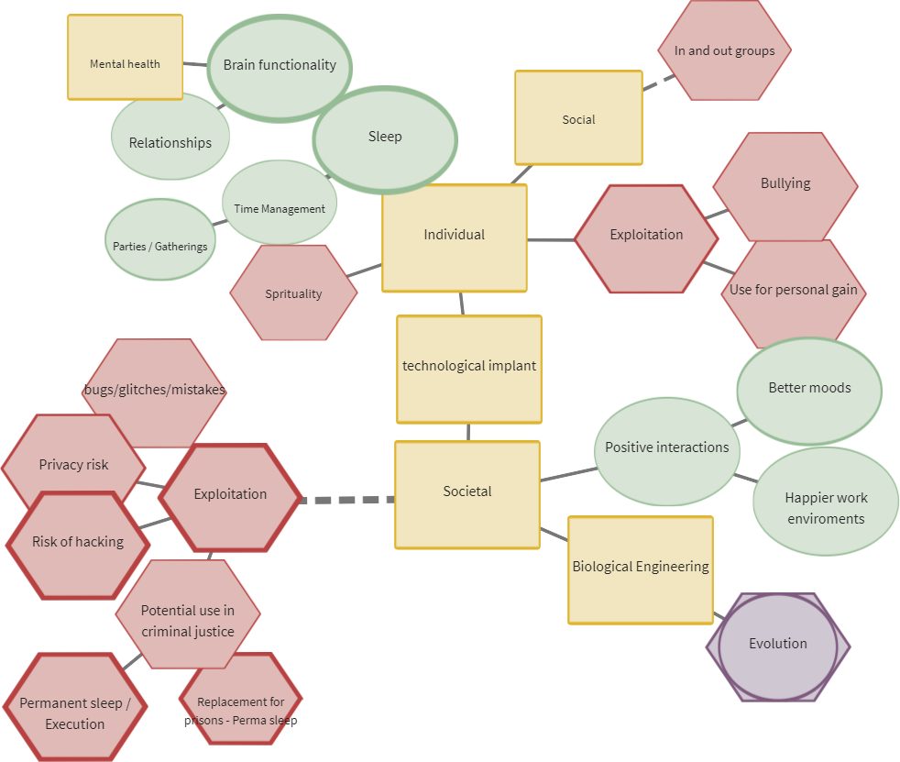
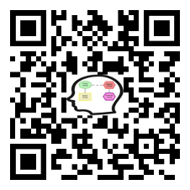







Cognitive Affective Maps to Motivate Attitude Change
An Experimental Study Design
Julius Fenn^{1,2}, Wilhelm Gros^{1,2}, Andrea Kiesel^{1,2}
¹ Cluster of Excellence livMatS, University of Freiburg, ² Institute of Psychology, University of Freiburg, Germany
Background
Figure 2 Allocation to experimental condition
Recently, data collection and analyses tools for Cognitive-Affective Maps (CAMs) as a quantitative and qualitative research tool have been developed to identify, visually represent and analyze existing belief structures. In comparison to associative methods or semantic networks CAMs also include affective evaluations. It is assumed that concepts are changed or added if they correspond to the „most coherent account of what we want to understand“ (see Thagard 2006).
Elements of a CAM:
Participants can freely add concepts (also called nodes), which are linked by connections (also called edges)
Concepts incorporate so-called affective valences by representing whether a person associates positive (green), negative (red), neutral (yellow) or ambivalent (purple) emotions with a drawn concept
It is possible to specify the connections in different strengths and forms
Methods
Conclusion
Study Design:
mixed design (2 time-points x 3 conditions); N = 75
(f = 26, m = 46, d = 1; age: M = 32.69, SD = 12.14)
participants who drew a CAM with positive connotations
at the first time-point elaborated a negative CAM and
vice versa (neutral CAMs were randomly allocated)
elaboration of a CAM of opposite affective connotation could motivate attitude change (Gros et al., 2021)
which is supported by a high re-test stability of CAMs
Possible Application-Case – adapted of the Mediation Phase Model:
pre-mediation phase involves one-on-one talks, conflict analysis, and implementation planning
search for a solution involves creative brainstorming, allowing all ideas, followed by filtering out inappropriate or unfeasible solutions through discussion
agreement, involves a thorough examination of the chosen solution before a binding agreement is signed when all parties are satisfied (see Proksch, 2018)
Results
a
b
elaborating on a CAM with opposing valence lead to a significant change in the affective evaluation of the own CAM
affective evaluations were stronger for participants who elaborated a negative CAM (-0.76) compared to participants who elaborated a positive CAM (.52); applying multivariate multilevel models participants have drawn more concepts when reflecting on a opposing CAM
Figure 3 Mean valence of CAMs
Figure 4 Number of drawn concepts
References
Further information
Example
Gros, W., Reuter, L., Stumpf, M., & Kiesel, A. (2021). CAMediaid: Multimethod approach to assess Cognitive-Affective Maps in mediation - A quantitative validation study. https://doi.org/10.13140/RG.2.2.12436.78726
Proksch, S. (2018). Mediation: Die Kunst der professionellen Konfliktlösung. Springer Fachmedien. https://doi.org/10.1007/978-3-658-22980-1
Thagard, P. (2006). Hot Thought: Mechanisms and Applications of Emotional Cognition. MIT Press.
central webpage: https://drawyourminds.de/
online-documentation: https://osf.io/q5hj4
Figure 1 Ideas, thoughts and assessment regarding a fictional technological implant
Acknowledgements
livMats is funded by the Deutsche Forschungsgemeinschaft (DFG, German Research Foundation) under Germany’s Excellence Strategy – EXC-2193/1 – 390951807 and the grant 2277, Research Training Group “Statistical Modeling in Psychology" (SMiP)
results are supported by relative high re-test stability: Pearson's product-moment correlations between the mean valence and number of drawn concepts within the control group are very large (r(38) = 0.63, 95% CI [0.40, 0.79]; respective r(38) = 0.68, 95% CI [0.47, 0.82])
Contact
Julius Fenn, M.Sc.
E-Mail: julius.fenn@psychologie.uni-freiburg.de
Phone: +49 761 203 9153

